Slide 1

Group 3
CS5330: Pattern Recognition & Computer Vision
Prof. Huaizu Jiang
Final Project Presentation
Optimizing 3D Scene Reconstruction: Integrating DUSt3R with 3D Gaussian Splatting
By
Daniel Allex
Tirth Patel

Slide 2
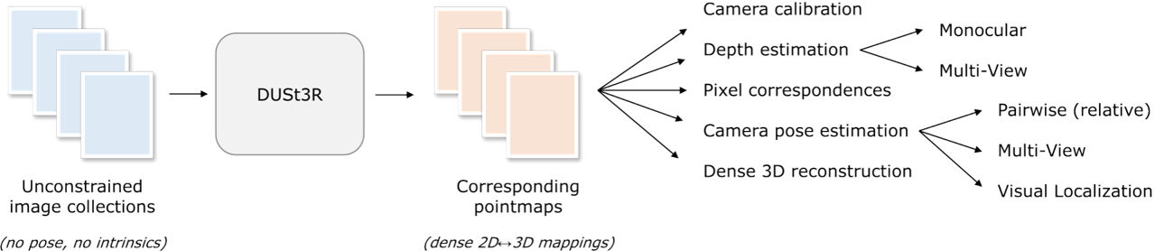
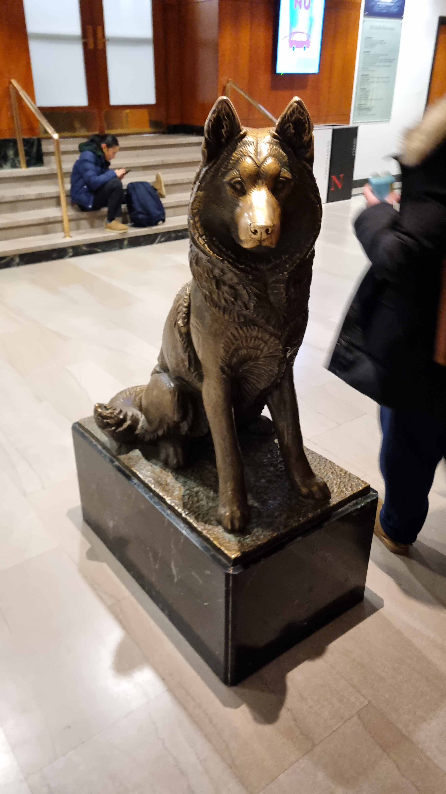
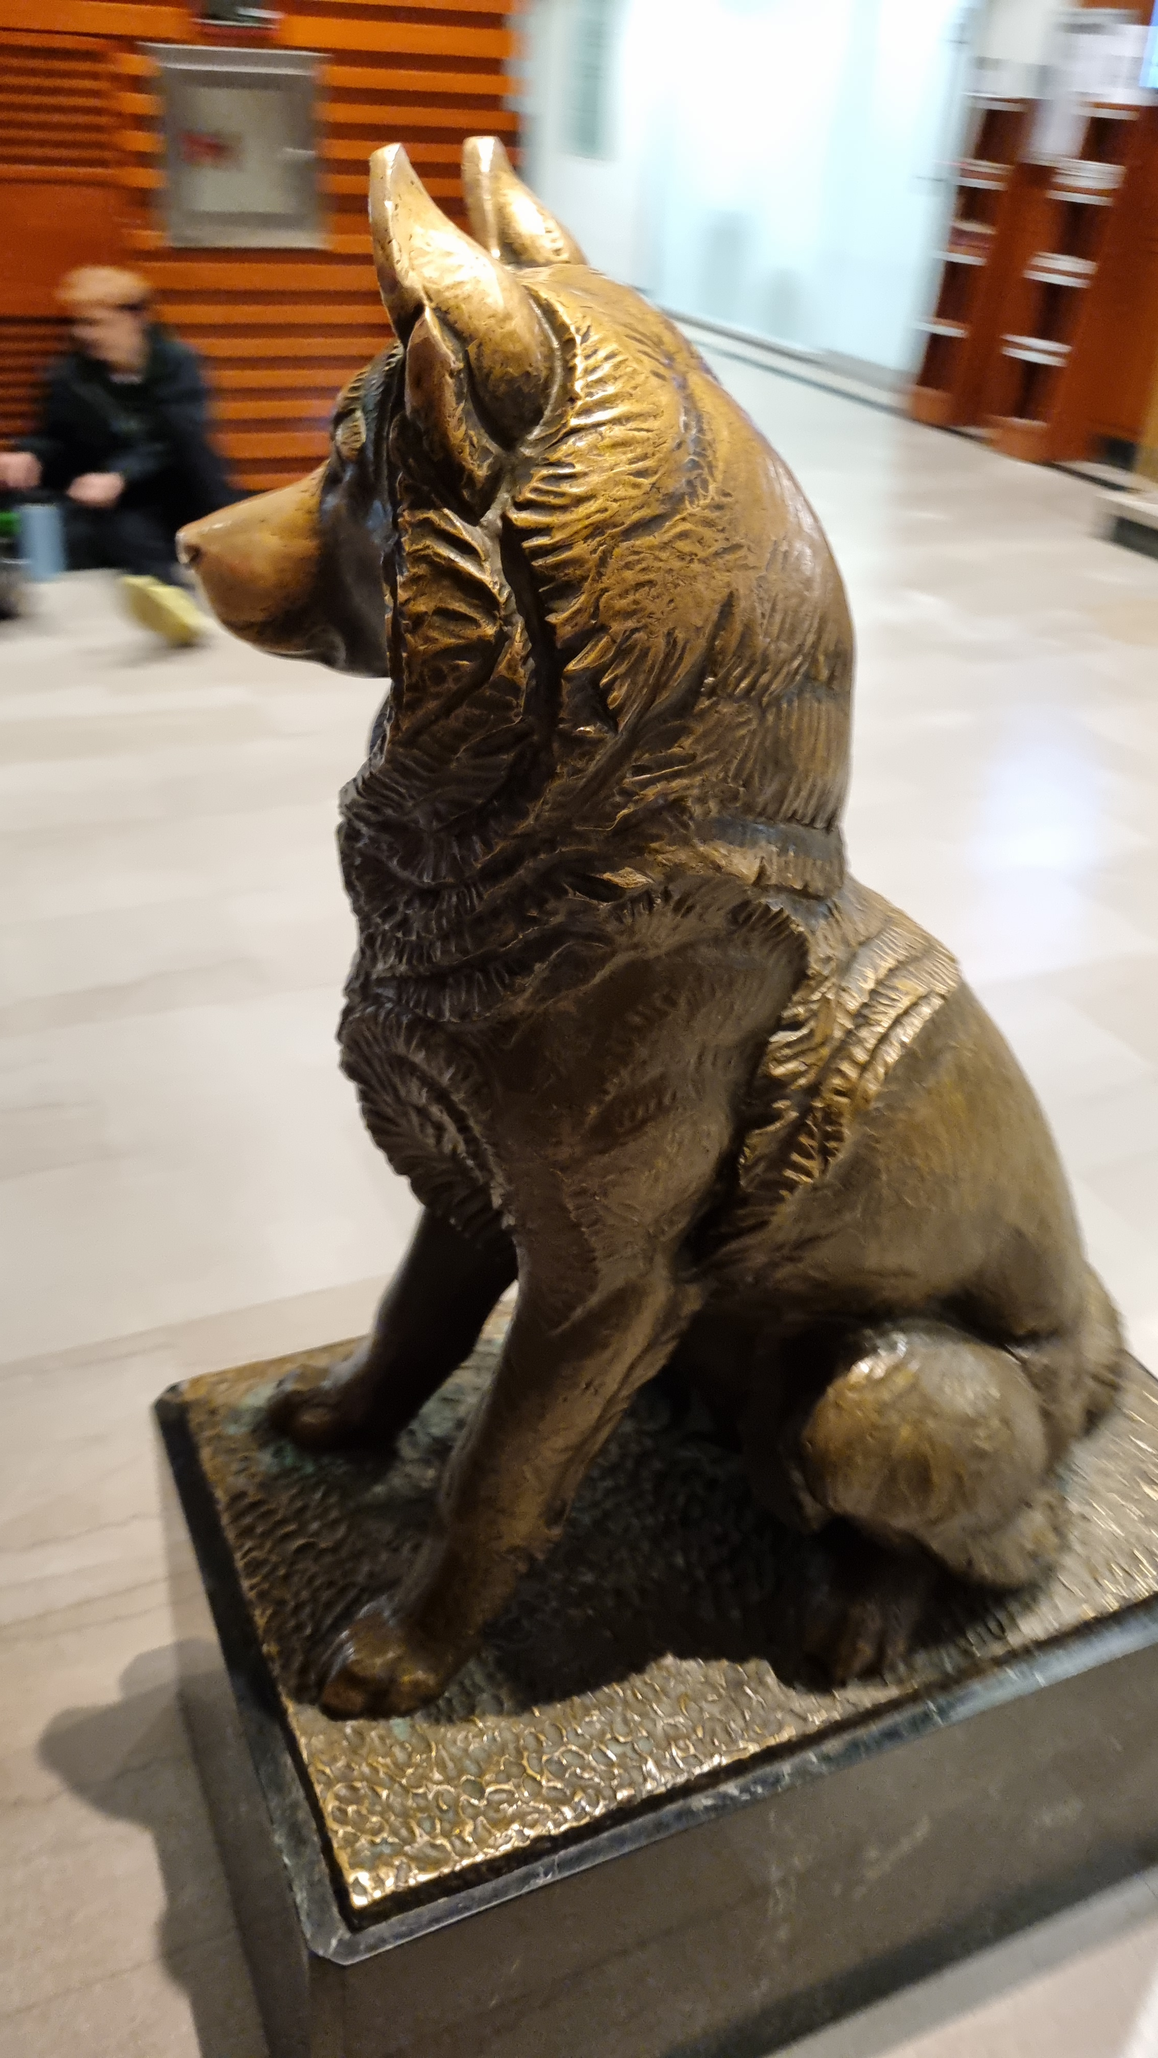
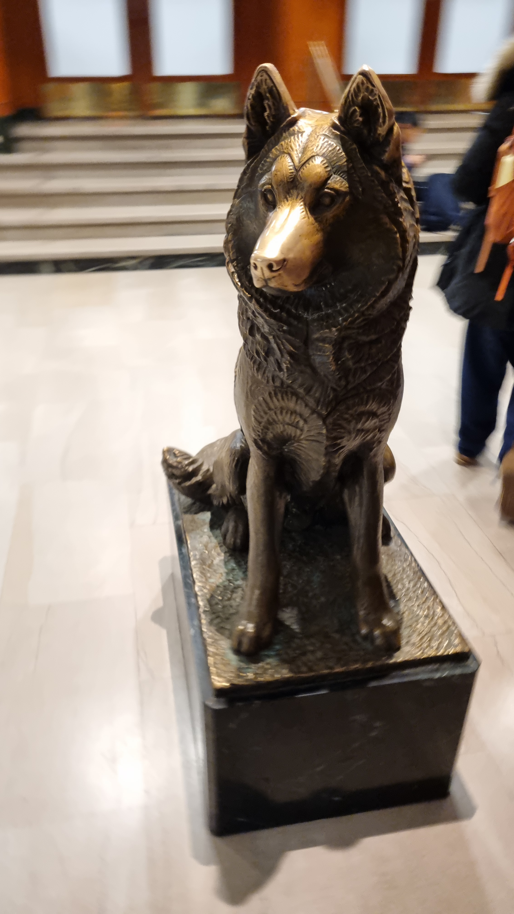
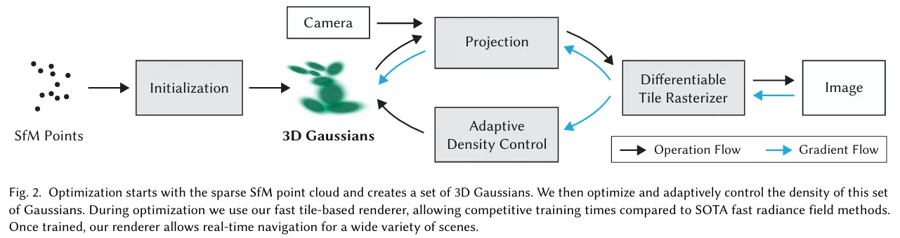
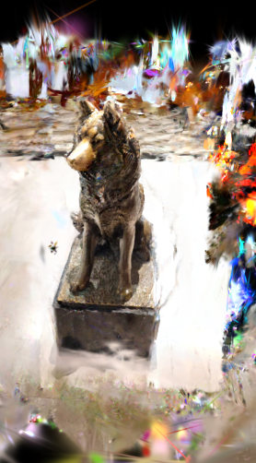
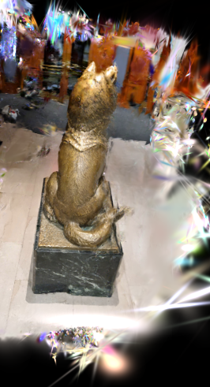
Problem Setting Model input and output

Slide 3
Baseline and Delta
Baselines: DUSt3R and Gaussian Splatting models
Delta:
Bridges DUSt3R's depth inference into Gaussian Splatting's training and rendering workflow
Applies global alignment to unify DUSt3R derived camera poses and point clouds
Normalizes scene geometry to ensure consistent scale and coordinate frames
Converts aligned, normalized data to COLMAP format to be useable by Gaussian Splatting
Baseline Notebook- COLMAP converter with Gaussian Splatting, taking images as inputs
Image training data across campus

Slide 4
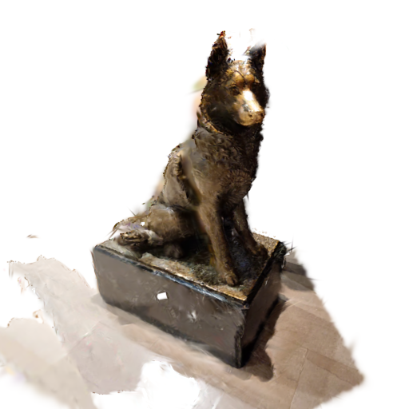
Empirical Results
Achieves comparable reconstructions and renderings to those generated via standard SfM pipelines
DUSt3r Splatting maintains coherent scene geometry without known intrinsics
Though includes more noise than baseline methods
DUSt3R Splatting
COLMAP + Gaussian Splatting

